Slide 1
Trigonometric
Functions
Twitter: @Owen134866
www.mathsfreeresourcelibrary.com

Slide 2

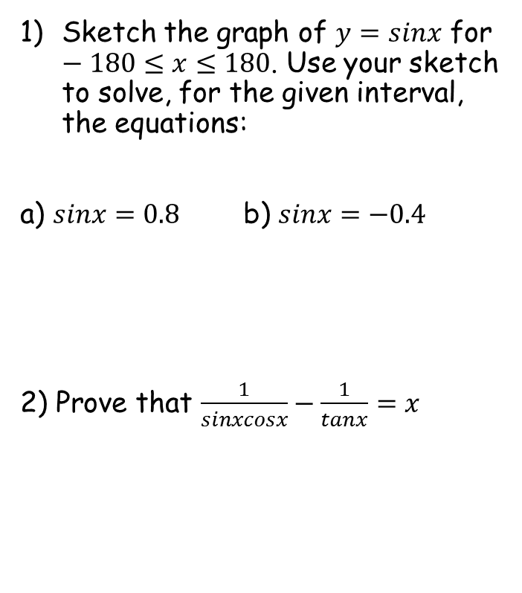
Prior Knowledge Check
Sketch the graph of $y=sinx$ for $−180≤x≤180$. Use your sketch to solve, for the given interval, the equations:
a) $sinx=0.8$ b) $sinx=−0.4$
2) Prove that $\frac{1}{sinxcosx}−\frac{1}{tanx}=x$
3) Find all the solutions in the interval $0≤x≤2π$ to the equation
$$3\sin^{2}\left(2x\right)=1$$
0.308, 1.26, 1.88, 2.83, 3.45, 4.40, 5.02, 5.98
53.1, 126.9
-23.6, -156.4

Slide 3
Teachings for
Exercise 6A

Slide 4
Trigonometric Functions
You need to know the functions secantθ, cosecantθ and cotangentθ
You should remember the index law:
It is NOT written like this in Trigonometry
All 3 are undefined if cosθ, sinθ or tanθ = 0
Something which will be VERY useful later in the chapter…
so
6A

Slide 5
Trigonometric Functions
You need to know the functions secantθ, cosecantθ and cotangentθ
Example Questions
Will cosec200 be positive or negative?
y = Sinθ
90
180
270
360
As sin200 is negative, cosec200 will be as well!
6A

Slide 6
Trigonometric Functions
You need to know the functions secantθ, cosecantθ and cotangentθ
Example Questions
Find the value of:
to 2dp
Just use your calculator!
6A

Slide 7
Trigonometric Functions
You need to know the functions secantθ, cosecantθ and cotangentθ
Example Questions
Find the value of:
to 2dp
Just use your calculator!
6A

Slide 8
Trigonometric Functions
You need to know the functions secantθ, cosecantθ and cotangentθ
30
-60
-60
y = Cosθ
Example Questions
90
180
270
360
210
Work out the exact value of:
By symmetry, we will get the same value for cos210 at cos30 (but with the reversed sign)
(you may need to use surds…)
Cos30 = ^{√3}/₂
Flip the denominator
6A

Slide 9
Trigonometric Functions
You need to know the functions secantθ, cosecantθ and cotangentθ
^{π}/₄
^{3π}/₄
y = Sinθ
^{π}/₂
π
^{3π}/₂
2π
Example Questions
Work out the exact value of:
→ Sin(^{3π}/₄) = Sin(^{π}/₄)
(you may need to use surds…)
Sin(^{π}/₄) = Sin45
→ ¹/_{√2}
Flip the denominator
6B

Slide 10
Teachings for
Exercise 6B

Slide 11
Trigonometric Functions
You need to know the graphs of secθ, cosecθ and cotθ
At 90°, Sinθ = 1
→ Cosecθ = 1
At 180°, Sinθ = 0
→ Cosecθ = undefined
→ We get an asymptote wherever Sinθ = 0
1
0
y = Sinθ
-1
90
180
270
360
y = Cosecθ
6B

Slide 12
Trigonometric Functions
You need to know the graphs of secθ, cosecθ and cotθ
At 0°, Cosθ = 1
→ Secθ = 1
At 90°, Cosθ = 0
→ Secθ = undefined
→ We get asymptotes wherever Cosθ = 0
1
y = Cosθ
0
-1
90
180
270
360
y = Secθ
6B

Slide 13
Trigonometric Functions
You need to know the graphs of secθ, cosecθ and cotθ
At 45°, tanθ = 1
→ Cotθ = 1
At 90°, tanθ = undefined
→ Cotθ = 0
y = Tanθ
90
180
270
360
y = Cotθ
At 180°, tanθ = 0
→ Cotθ = undefined
6B

Slide 14
Trigonometric Functions
You need to know the graphs of secθ, cosecθ and cotθ
1
0
y = Sinθ
-1
90
180
270
360
Maxima/Minima at (90,1) and (270,-1)
(and every 180 from then)
1
0
-1
90
180
270
360
Asymptotes at 0, 180, 360
(and every 180° from then)
y = Cosecθ
6B

Slide 15
Trigonometric Functions
You need to know the graphs of secθ, cosecθ and cotθ
1
y = Cosθ
0
-1
90
180
270
360
Maxima/Minima at (0,1) (180,-1) and (360,1)
(and every 180 from then)
1
0
-1
90
180
270
360
Asymptotes at 90 and 270
(and every 180° from then)
y = Secθ
6B

Slide 16
Trigonometric Functions
You need to know the graphs of secθ, cosecθ and cotθ
y = Tanθ
90
180
270
360
Asymptotes at 0, 180 and 360
(and every 180° from then)
90
180
270
360
y = Cotθ
6B

Slide 17
Trigonometric Functions
You need to know the graphs of secθ, cosecθ and cotθ
Sketch, in the interval 0 ≤ θ ≤ 360, the graph of:
y = Secθ
1
0
-1
90
180
270
360
y = 1 + Sec2θ
2
Horizontal stretch, scale factor ¹/₂
1
y = Sec2θ
0
Vertical translation, 1 unit up
-1
90
180
270
360
6B

Slide 18











Trigonometric Functions
The graph will be stretched vertically by a factor of 4 (y coordinates are multiplied by 4)
Remember that as this is a sketch, you can use the labelling of the axes to ‘stretch’ it
You need to know the graphs of secθ, cosecθ and cotθ
a) Sketch the graph of:
$y=4cosecx,$ $0≤x≤2π$
4
1
0
$$π$$
$$\frac{π}{2}$$
$$\frac{3π}{2}$$
$$2π$$
0
$$π$$
$$\frac{π}{2}$$
$$\frac{3π}{2}$$
$$2π$$
-4
-1
$$y=4cosecx$$
$$y=cosecx$$
6B

Slide 19

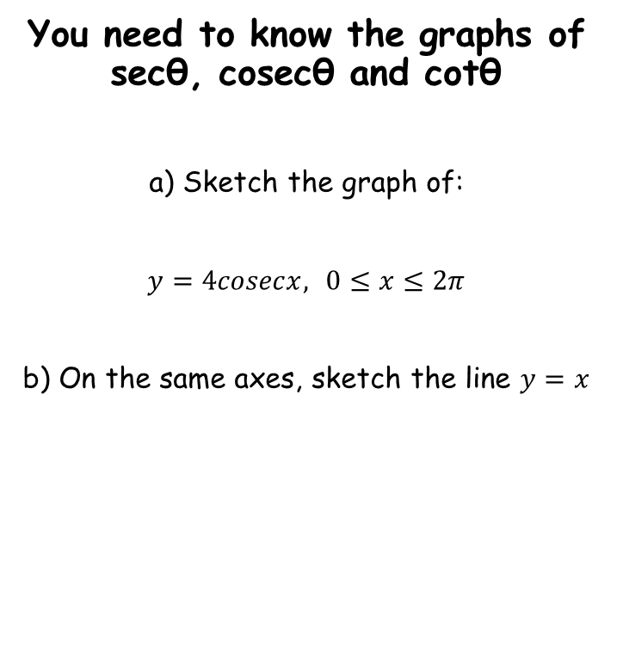






Trigonometric Functions
You need to know the graphs of secθ, cosecθ and cotθ
a) Sketch the graph of:
$y=4cosecx,$ $0≤x≤2π$
b) On the same axes, sketch the line $y=x$
$$y=x$$
4
0
$$π$$
$$\frac{π}{2}$$
$$\frac{3π}{2}$$
$$2π$$
-4
So when $x=\frac{π}{2}$, $y=\frac{π}{2}$ etc…
$$y=4cosecx$$
6B

Slide 20
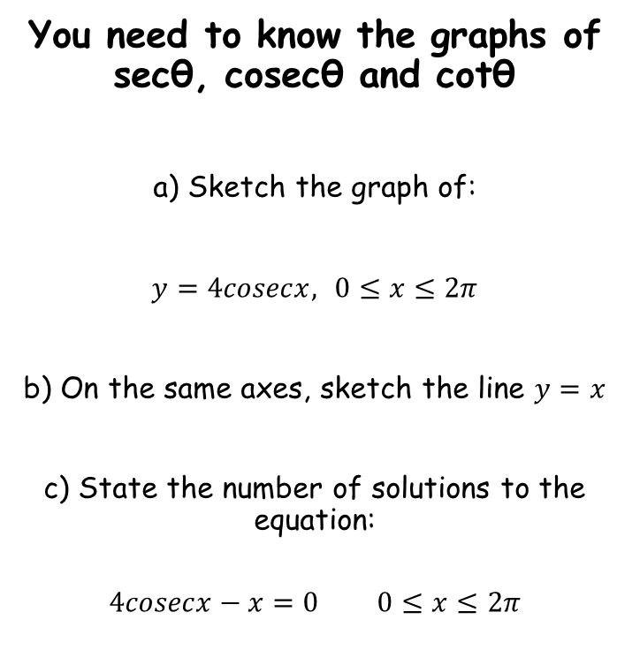

Trigonometric Functions
You need to know the graphs of secθ, cosecθ and cotθ
a) Sketch the graph of:
$y=4cosecx,$ $0≤x≤2π$
b) On the same axes, sketch the line $y=x$
c) State the number of solutions to the equation:
$$4cosecx−x=0 0≤x≤2π$$
$$y=x$$
4
0
$$π$$
$$\frac{π}{2}$$
$$\frac{3π}{2}$$
$$2π$$
-4
$$y=4cosecx$$
Add x
Since the graphs do not intersect in this region, there are no solutions to the equation
$$4cosecx=x$$
6B

Slide 21
Teachings for
Exercise 6C

Slide 22
Trigonometric Functions
You need to be able to simplify expressions, prove identities and solve equations involving secθ, cosecθ and cotθ
This is similar to the work covered in Year 12, but there are now more possibilities
As in Year 12, you must practice as much as possible in order to get a ‘feel’ for what to do and when…
Example Questions
Simplify…
Remember how we can rewrite cotθ from earlier?
Group up as a single fraction
Numerator and denominator are equal
6C

Slide 23
Trigonometric Functions
You need to be able to simplify expressions, prove identities and solve equations involving secθ, cosecθ and cotθ
This is similar to the work covered in Year 12, but there are now more possibilities
As in Year 12, you must practice as much as possible in order to get a ‘feel’ for what to do and when…
Example Questions
Simplify…
Rewrite the part in brackets
Multiply each fraction by the opposite’s denominator
Group up since the denominators are now the same
Multiply the part on top by the part outside the bracket
Cancel the common factor to the top and bottom
6C

Slide 24
Trigonometric Functions
Putting them together
Show that:
Replace numerator and denominator
Left side
Numerator
Denominator
This is just a division
Rewrite both
Rewrite both
Multiply by the opposite’s denominator
Change to a multiplication
Group up
Group up
Group up
From C2
→ sin²θ+ cos²θ = 1
Simplify
6C

Slide 25
Trigonometric Functions
You need to be able to simplify expressions, prove identities and solve equations involving secθ, cosecθ and cotθ
You can solve equations by rearranging them in terms of sin, cos or tan, then using their respective graphs
Rewrite using cos
Rearrange
Work out the fraction
Inverse cos
Work out the first answer. Add 360 if not in the range we want…
Example Question
Subtract from 360 (to find the equivalent value in the range
Solve the equation:
In the range:
1
y = Cosθ
0
-1
90
180
270
360
6C

Slide 26
Trigonometric Functions
You need to be able to simplify expressions, prove identities and solve equations involving secθ, cosecθ and cotθ
You can solve equations by rearranging them in terms of sin, cos or tan, then using their respective graphs
Rewrite using tan
Inverse tan
Work out the first value, and others in the original range (0-360)
You can add 180 to these as the period of tan is 180
Divide all by 2 (answers to 3sf)
Example Question
Solve the equation:
In the range:
y = Tanθ
90
180
270
360
Remember to adjust the acceptable range for 2θ
6C

Slide 27

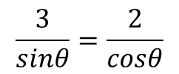

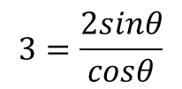
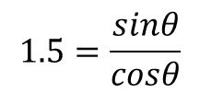




Trigonometric Functions
You need to be able to simplify expressions, prove identities and solve equations involving secθ, cosecθ and cotθ
You can solve equations by rearranging them in terms of sin, cos or tan, then using their respective graphs
Rewrite each side
Cross multiply
Divide by Cosθ
Divide by 2
Example Question
Rewrite the right-hand side
Solve the equation:
In the range:
6C

Slide 28
Teachings for
Exercise 6D

Slide 29
Trigonometric Functions
Example Question
Given that:
Replace A and H from the triangle…
and A is obtuse, find the exact value of secA
A is obtuse (in the 2nd quadrant)
→ Cos is negative in this range
1
y = Cosθ
0
-1
90
180
270
360
13
5
Flip the fraction to get Secθ
θ
12
Ignore the negative, and use Pythagoras to work out the missing side…
6D

Slide 30
Trigonometric Functions
Example Question
Given that:
Replace A and H from the triangle…
and A is obtuse, find the exact value of cosecA
A is obtuse (in the 2nd quadrant)
→ Sin is positive in this range
1
0
y = Sinθ
-1
90
180
270
360
13
5
Flip the fraction to get Secθ
θ
12
Ignore the negative, and use Pythagoras to work out the missing side…
6D

Slide 31

Trigonometric Functions
$$\tan^{2}θ+1≡\sec^{2}θ$$
You need to know and be able to use the following identities
You might be asked to show where these come from…
Divide all by cos²θ
Simplify each part
6D

Slide 32

Trigonometric Functions
$$\tan^{2}θ+1≡\sec^{2}θ$$
$$1+\cot^{2}≡{cosec}^{2}θ$$
You need to know and be able to use the following identities
You might be asked to show where these come from…
Divide all by sin²θ
Simplify each part
6D

Slide 33
Trigonometric Functions
$$\tan^{2}θ+1≡\sec^{2}θ$$
$$1+\cot^{2}≡{cosec}^{2}θ$$
Left hand side
Example Question
Prove that:
Factorise into a double bracket
Replace cosec²θ
The second bracket = 1
1
Rewrite
Group up into 1 fraction
Rearrange the bottom (as in Y12)
6D

Slide 34
Trigonometric Functions
$$\tan^{2}θ+1≡\sec^{2}θ$$
$$1+\cot^{2}≡{cosec}^{2}θ$$
Right hand side
Example Question
Prove that:
Multiply out the bracket
Replace sec²θ
Rewrite the second term
This requires a lot of practice and will be slow to begin with. The more questions you do, the faster you will get!
Replace the fraction
Rewrite both terms based on the inequalities
The 1s cancel out…
6D

Slide 35
Trigonometric Functions
$$\tan^{2}θ+1≡\sec^{2}θ$$
$$1+\cot^{2}≡{cosec}^{2}θ$$
Example Question
Replace cosec²θ
Solve the Equation:
in the interval:
Multiply out the bracket
A general strategy is to replace terms until they are all of the same type (eg cosθ, cotθ etc…)
Group terms on the left side
Factorise
⁴/₅
y = Tanθ
-1
90
180
270
360
Solve
or
Invert so we can use the tan graph
or
Use a calculator for the first answer
→ Be sure to check for others in the given range
6D

Slide 36
Teachings for
Exercise 6E

Slide 37
Trigonometric Functions
You need to be able to use the inverse trigonometric functions, arcsinx, arccosx and arctanx
These are the inverse functions of sin, cos and tan respectively
However, an inverse function can only be drawn for a one-to-one function
(when reflected in y = x, a many-to-one function would become one-to many, hence not a function)
y = x
y = arcsinx
^{π}/₂
1
y = sinx
-^{π}/₂
-1
1
^{π}/₂
-1
-^{π}/₂
y = sinx
y = arcsinx
Remember that from a function to its inverse, the domain and range swap round (as do all co-ordinates)
Domain: -^{π}/₂ ≤ x ≤ ^{π}/₂
Domain: -1 ≤ x ≤ 1
Range: -1 ≤ sinx ≤ 1
Range: -^{π}/₂ ≤ arcsinx ≤ ^{π}/₂
6E

Slide 38
Trigonometric Functions
y = arccosx
π
You need to be able to use the inverse trigonometric functions, arcsinx, arccosx and arctanx
These are the inverse functions of sin, cos and tan respectively
However, an inverse function can only be drawn for a one-to-one function
(when reflected in y = x, a many-to-one function would become one-to many, hence not a function)
y = x
We can’t use –^{π}/₂ ≤ x ≤ ^{π}/₂ as the domain for cos, since it is many-to-one…
^{π}/₂
1
-1
1
^{π}/₂
π
-1
y = cosx
y = cosx
y = arccosx
Remember that from a function to its inverse, the domain and range swap round (as do all co-ordinates)
Domain: 0 ≤ x ≤ π
Domain: -1 ≤ x ≤ 1
Range: -1 ≤ cosx ≤ 1
Range: 0 ≤ arccosx ≤ π
6E

Slide 39
Trigonometric Functions
You need to be able to use the inverse trigonometric functions, arcsinx, arccosx and arctanx
These are the inverse functions of sin, cos and tan respectively
However, an inverse function can only be drawn for a one-to-one function
(when reflected in y = x, a many-to-one function would become one-to many, hence not a function)
y = tanx
^{π}/₂
y = arctanx
-^{π}/₂
^{π}/₂
-^{π}/₂
y = tanx
y = arctanx
Subtle differences…
The domain for tanx cannot equal ^{π}/₂ or –^{π}/₂
The range can be any real number!
Domain: -^{π}/₂ < x < ^{π}/₂
Domain: x ε R
Range: x ε R
Range: -^{π}/₂ < arctanx < ^{π}/₂
6E

Slide 40
Trigonometric Functions
y = arccosx
π
^{π}/₂
^{π}/₂
y = arcsinx
-1
1
^{π}/₂
y = arctanx
-1
1
-^{π}/₂
-^{π}/₂
6E

Slide 41
Trigonometric Functions
You need to be able to use the inverse trigonometric functions, arcsinx, arccosx and arctanx
Work out, in radians, the value of:
Arcsin just means inverse sin…
Remember the exact values from earlier…
6E

Slide 42
Trigonometric Functions
You need to be able to use the inverse trigonometric functions, arcsinx, arccosx and arctanx
Work out, in radians, the value of:
Arctan just means inverse tan…
Remember the exact values from earlier…
6E

Slide 43
Trigonometric Functions
You need to be able to use the inverse trigonometric functions, arcsinx, arccosx and arctanx
Work out, in radians, the value of:
Arcsin just means inverse sin…
Ignore the negative for now, and remember the values from earlier…
Sin(-θ) = -Sinθ
(or imagine the Sine graph…)
1
y = sinx
^{√2}/₂
-^{π}/₄
-^{π}/₂
^{π}/₄
^{π}/₂
-^{√2}/₂
-1
6E

Slide 44
Trigonometric Functions
You need to be able to use the inverse trigonometric functions, arcsinx, arccosx and arctanx
Work out, in radians, the value of:
Arcsin just means inverse sin…
Think about what value you need for x to get Sin x = –1
Cos(-θ) = Cos(θ)
y = sinx
Remember it, or read from the graph…
1
1
y = cosx
-^{π}/₂
^{π}/₂
-^{π}/₂
^{π}/₂
-1
-1
6E

